Slide 1
gameShop
500,000+ games from multiple platforms
The power is in your hands!

Slide 2
Table of contents
00
01
02
03
04
05
06
Overview
RAWG
RAWG Endpoints
STRIPE
STRIPE Endpoints
Technologies
UI

Slide 3
0
Overview

Slide 4

Overview
Our online ecommerce video game web app is designed to offer gamers a seamless and engaging platform to purchase digital games.
We offer a wide variety of games across different genres
We strive for a user-friendly interface that is easy to use and navigate
We offer secure transaction processes
Our website aims to be the go-to destination for gamers seeking quality digital game purchases.

Slide 5
01
RAWG

Slide 6
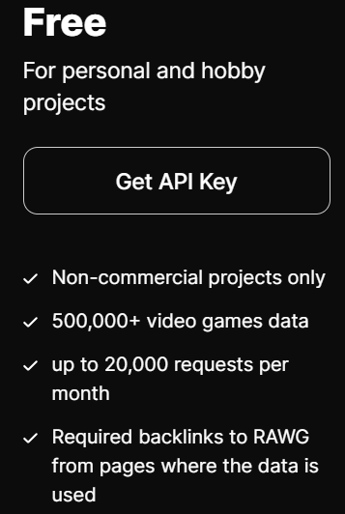
RAWG Video Game API
More than 500,000 games for multiple platforms including mobiles.
Rich metadata: tags, genres, developers, publishers, individual creators, official websites, release dates, Metacritic ratings.
Where to buy: links to digital distribution services
Player activity data: Steam average playtime and RAWG player counts and ratings.
Actively developing and constantly getting better by user contribution and our algorithms.

Slide 7
2
RAWG ENDPOINTS

Slide 8
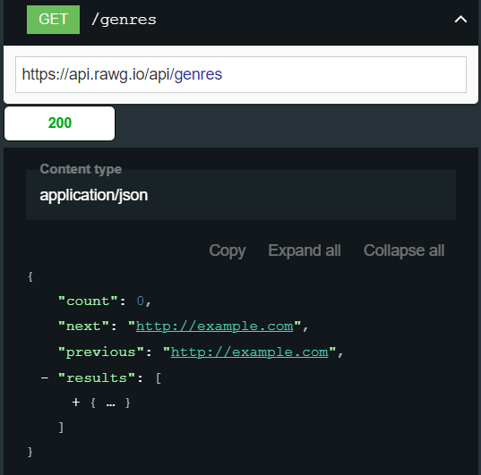
RAWG API ENDPOINTS
Games Endpoint
Retrieve detailed information about individual games.
Platforms Endpoint
Get a list of gaming platforms and their details.
Genres Endpoint
Access a list of game genres.
Developers and Publishers Endpoints
Retrieve information about game developers and publishers.
.
Reviews and Ratings Endpoint
Access user reviews and ratings for games.
Search Endpoint
Perform searches across the game database.

Slide 9
3
STRIPE

Slide 10
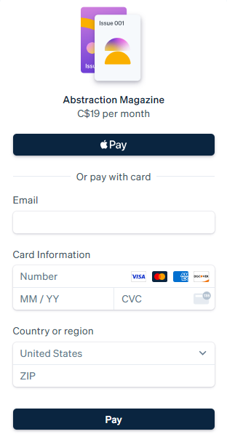
STRIPE PAYMENT API
Stripe is a comprehensive payment processing platform that allows businesses to accept payments online
The Stripe API is designed to be flexible and developer-friendly, providing powerful tools to integrate payment processing into websites, mobile apps, and other platforms.
STRIPE CHECKOUT is a low-code payment integration that creates a customizable form for collecting payments. You can embed Checkout directly in your website or redirect customers to a Stripe-hosted payment page.

Slide 11
4
STRIPE ENDPOINTS

Slide 12
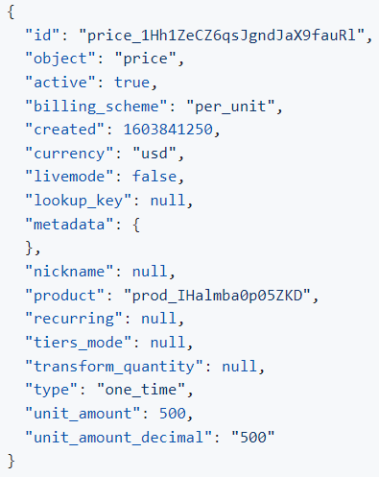
STRIPE PAYMENT API ENDPOINTS
Charges Endpoint
Create and manage one-time charges.
Customers Endpoint
Create and manage customer records.
Payment Intents Endpoint
Handle the entire payment lifecycle, including confirmation and cancellation.
Invoices Endpoint
Generate and manage invoices.
Balance Endpoint
Retrieve account balance and transaction history.

Slide 13
5
TECHNOLOGIES

Slide 14
TECHNOLOGIES
FRONTEND
BACKEND
ReactJS
CSS
Bootstrap Icons
Express
MongoDB
NodeJS

Slide 15
useEffect END
https://github.com/adinashby-vanier-college/project-starter-transactional-web-project
const teamMembers = {
{ name: "David Lafleur”, “Banya Honsa Nghm”, “Jeiberth Malagon”}}

Slide 16
6
User Interface

Slide 17



Slide 18




Slide 19
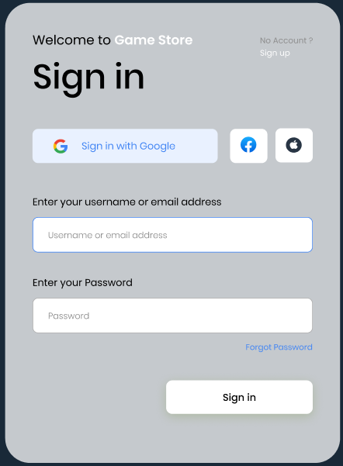
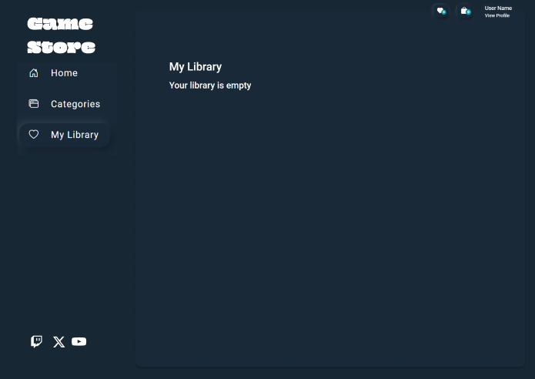

Slide 20
